Slide 1
P118 Overview
Eric Prebys

Slide 2
Lectures
9/24: Introduction and Goals
10/1: Lies, Damned Lies, and Statistics
10/8: Energy: No Such Thing as a Free Lunch
10/15: Bad Medicine
10/22: Worse Medicine
10/29: Criminally Bad Forensic Science
11/5: Bad Science in the Service of Racism
11/12: Satanic Panic, etc: Science Bearing False Witness
11/19: Spooky Bad Paranormal Studies
11/26: The Media and Science: Friends or Foes?
12/3: Climate Studies: When Science and Politics Mix

Slide 3

My Background
1984: BS in Engineering Physics, University of Arizona
  Got a job in an HEP group after being fired from a gas station.
1984-1990: Grad Student, University of Rochester
  PhD topic: Direct Photon Production in Hadronic Interactions
1990-1992: CERN Fellow, CERN
  Studied e+e- reactions on the OPAL Experiment at LEP
1992-2001: Postdoc and Assistant Professor, Princeton U.
  GEM Experiment at the Superconducting Super Collider
  Belle CP Violation Experiment at KEK, Japan
  Nonlinear QED in E-144 Experiment at SLAC
2001-2017: Scientist, Fermilab
  MiniBooNE short baseline neutrino oscillation experiment
  Proton Source Department Head
  Director of LHC Accelerator Research Program (LARP)
  Mu2e rare muon conversion experiment
  Created Lee Teng Internship and ran it for 10 years
2017-present, Professor, UC Davis
  Mu2e
  Director, Crocker Nuclear Laboratory (cyclotron)
Experimental HEP
Accelerator Physics and HEP

Slide 4
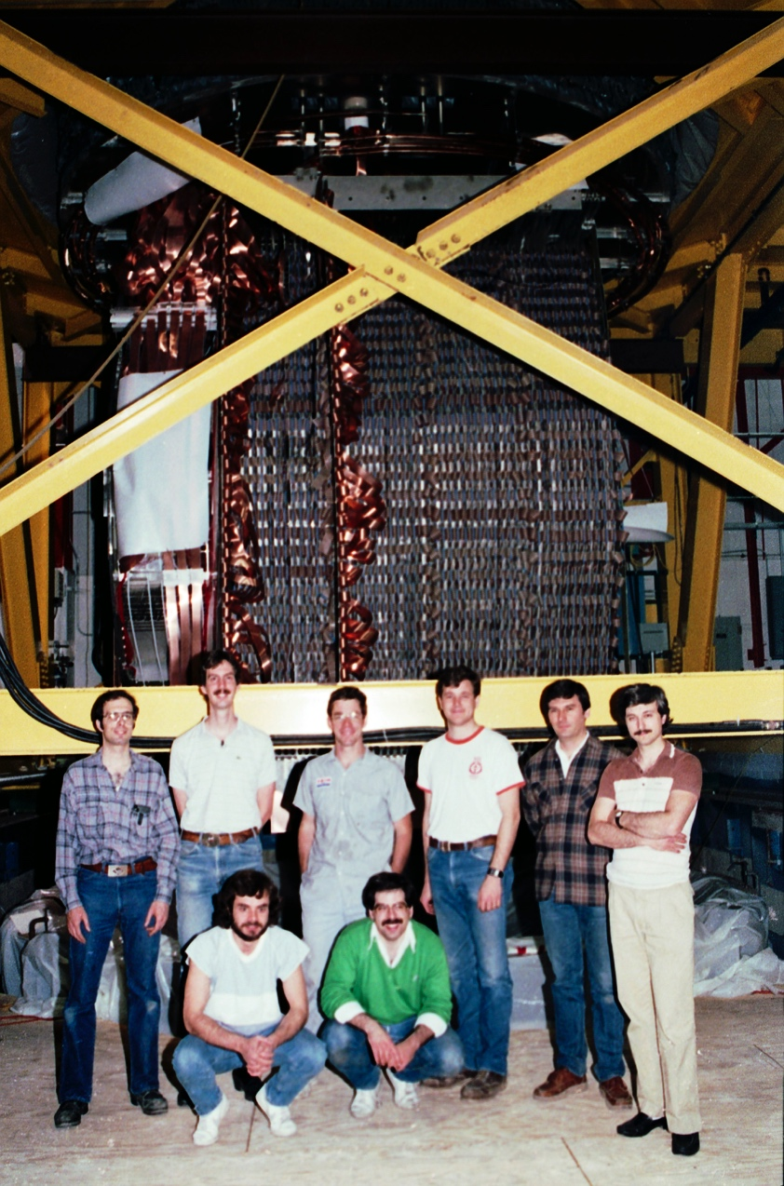
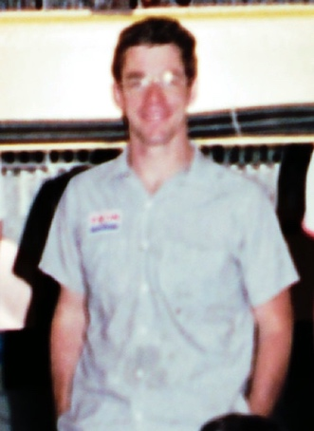
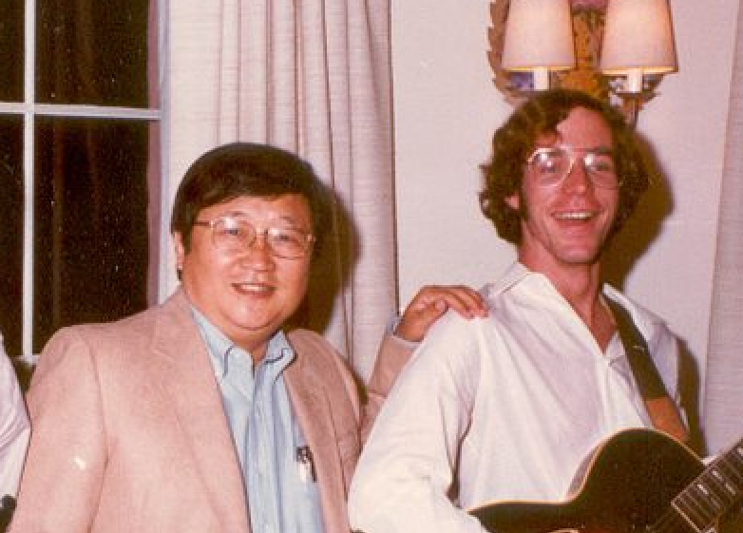
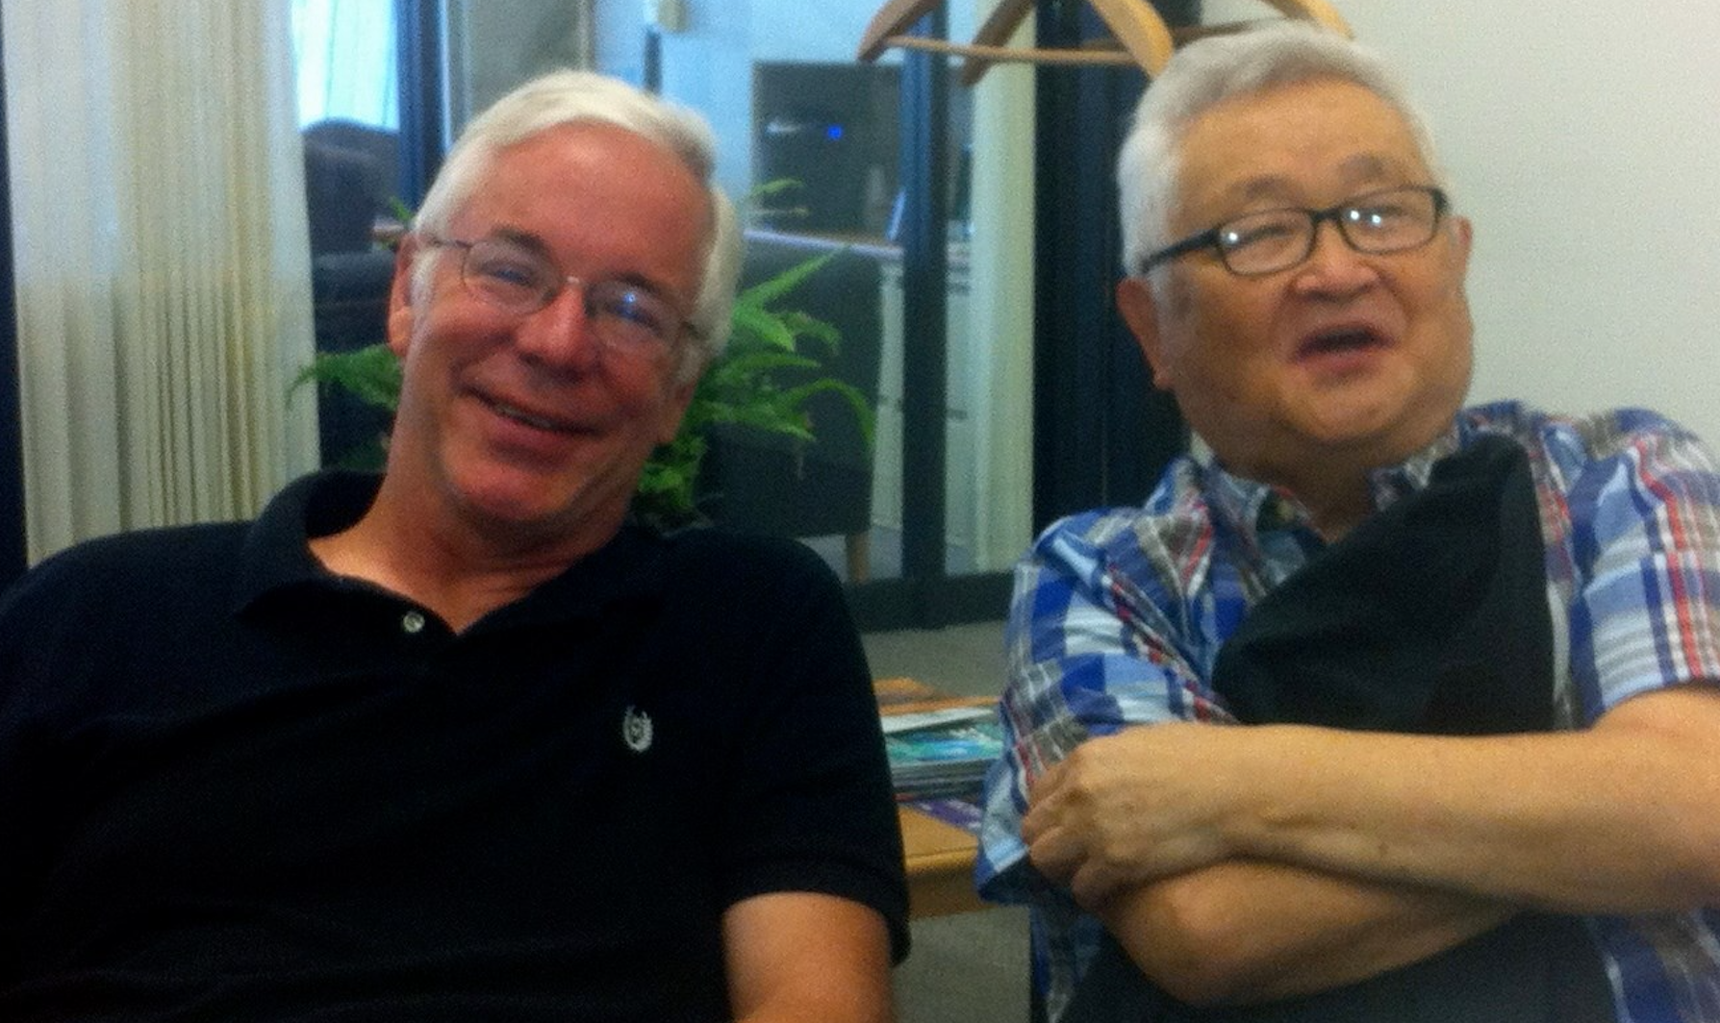
“Buck’s River Road Exxon”
Me
Kwan Lai, the guy that hired me
Fermilab E-706 Rochester Group
~1987
Recent
Then

Slide 5
General Comments on 118 vs. 117
There’s significantly less math and physics in 118 than in 117, at least at the beginning, but it has its own complexities
Once we transition to FPGA and SoC design, students with programming experience – particularly in C or Java – will have a significant advantage.
Don’t be afraid to speak up if you’re having problems!

